Slide 1
Local Oyster Stock for Restoration:
Does Local Adaptation Affect Outplanting?
Jake Heare, Joth Davis, Brent Vadopalas, Steven Roberts

Slide 2
Outline
Why Local Stocks?
  O. lurida history
  Key Metrics
  Expectations
Experiment
  Brood/Outplant
  Winter Fieldwork
  Summer Fieldwork
Results
  Mortality
  Growth
  Reproduction
Conclusion
  Summary
  Implications
  Future Work
Q/A?

Slide 3
Outline
Why Local Stocks?
Experiment
Results
Conclusion

Slide 4
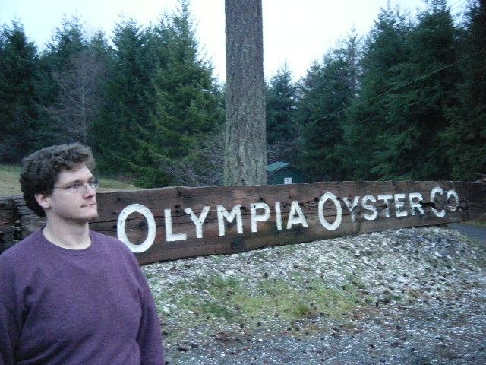
Brief History of Olympia Oysters
Ostrea lurida Native to Puget Sound
Culturally & Commerically Important
Heavy Declines
Model for Restoration

Slide 5
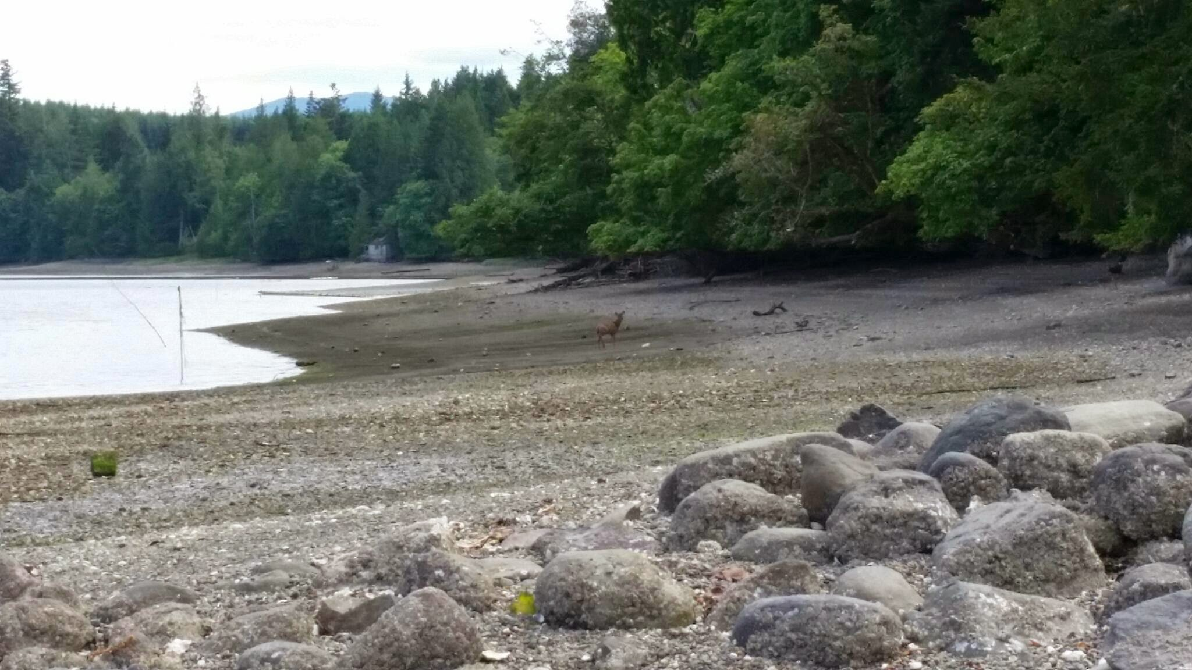
Why Local Stocks May Be Important
Assumed Adaptation
No Scale
Bay or Region?
Ensure Success

Slide 6
Outline
Why Local Stocks?
Experiment
Results
Conclusion

Slide 7
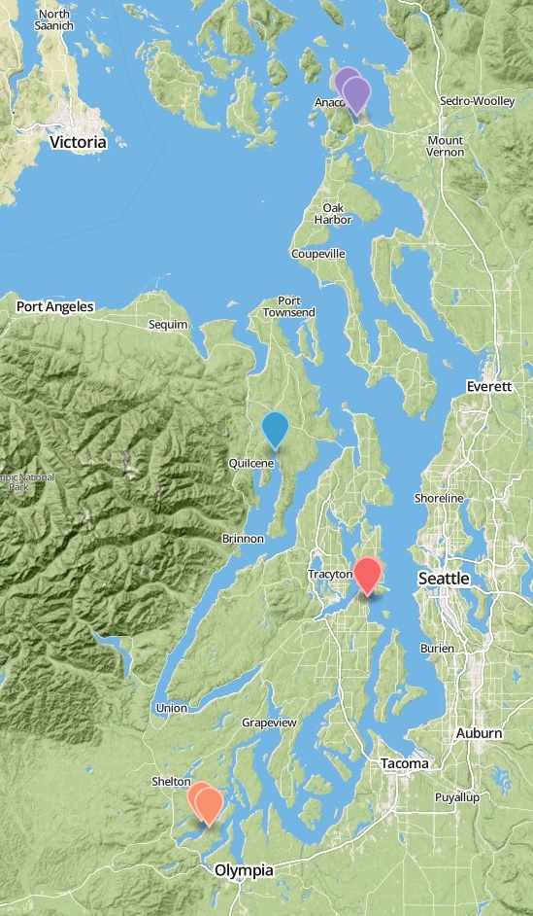
Experiment Basics
Reciprocal Transplant
Monitor
  3 Groups
  4 Sites
  1 Year
3 Home Sites
1 Foreign Site

Slide 8
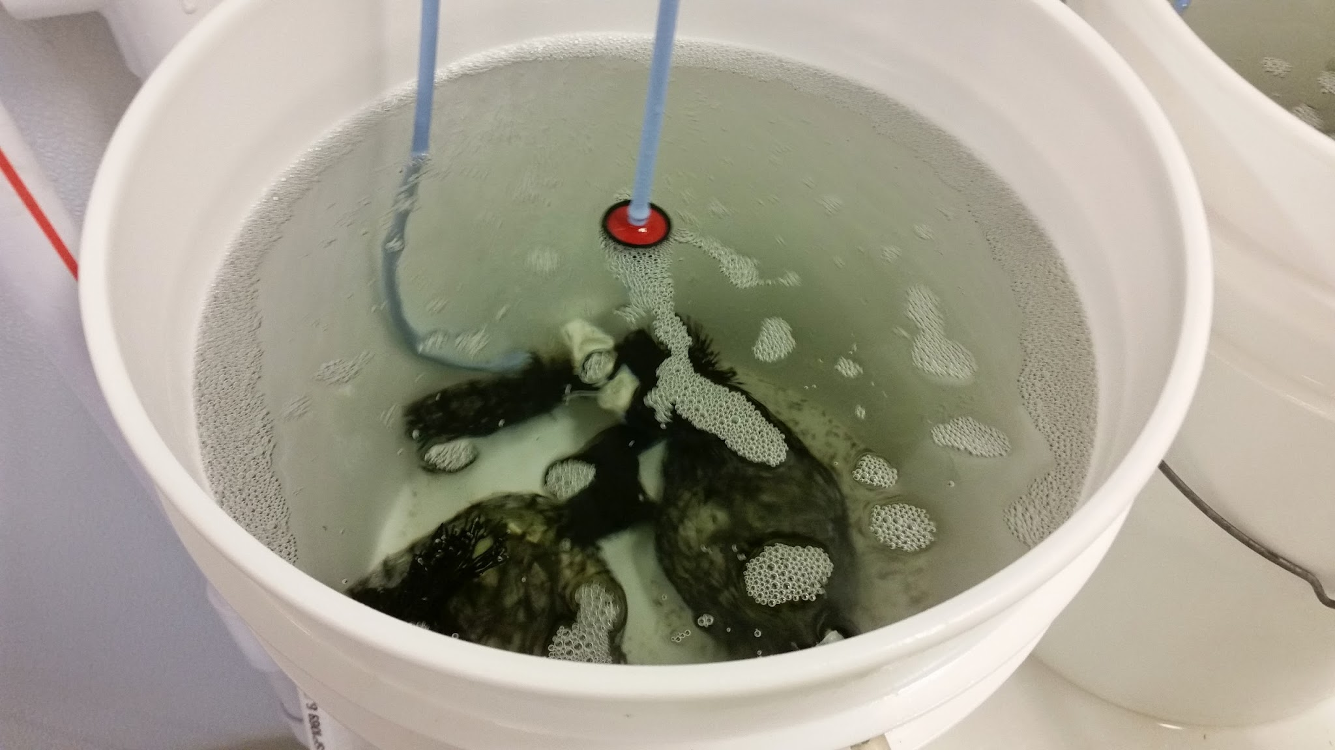
Broodstock and Outplanting
Broodstock
Collected by PSRF
Conditioned at Port Gamble
June 2013
Outplant
Larvae cultured by PSRF
Common Garden Conditions
August 2013

Slide 9
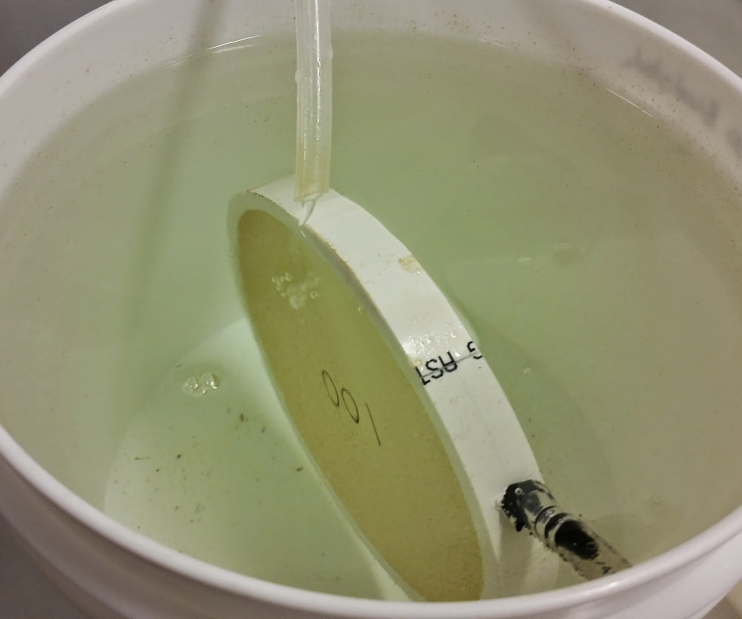
Broodstock and Outplanting
Broodstock
Collected by PSRF
Conditioned at Port Gamble
June 2013
Outplant
Larvae cultured by PSRF
Common Garden Conditions
August 2013

Slide 10
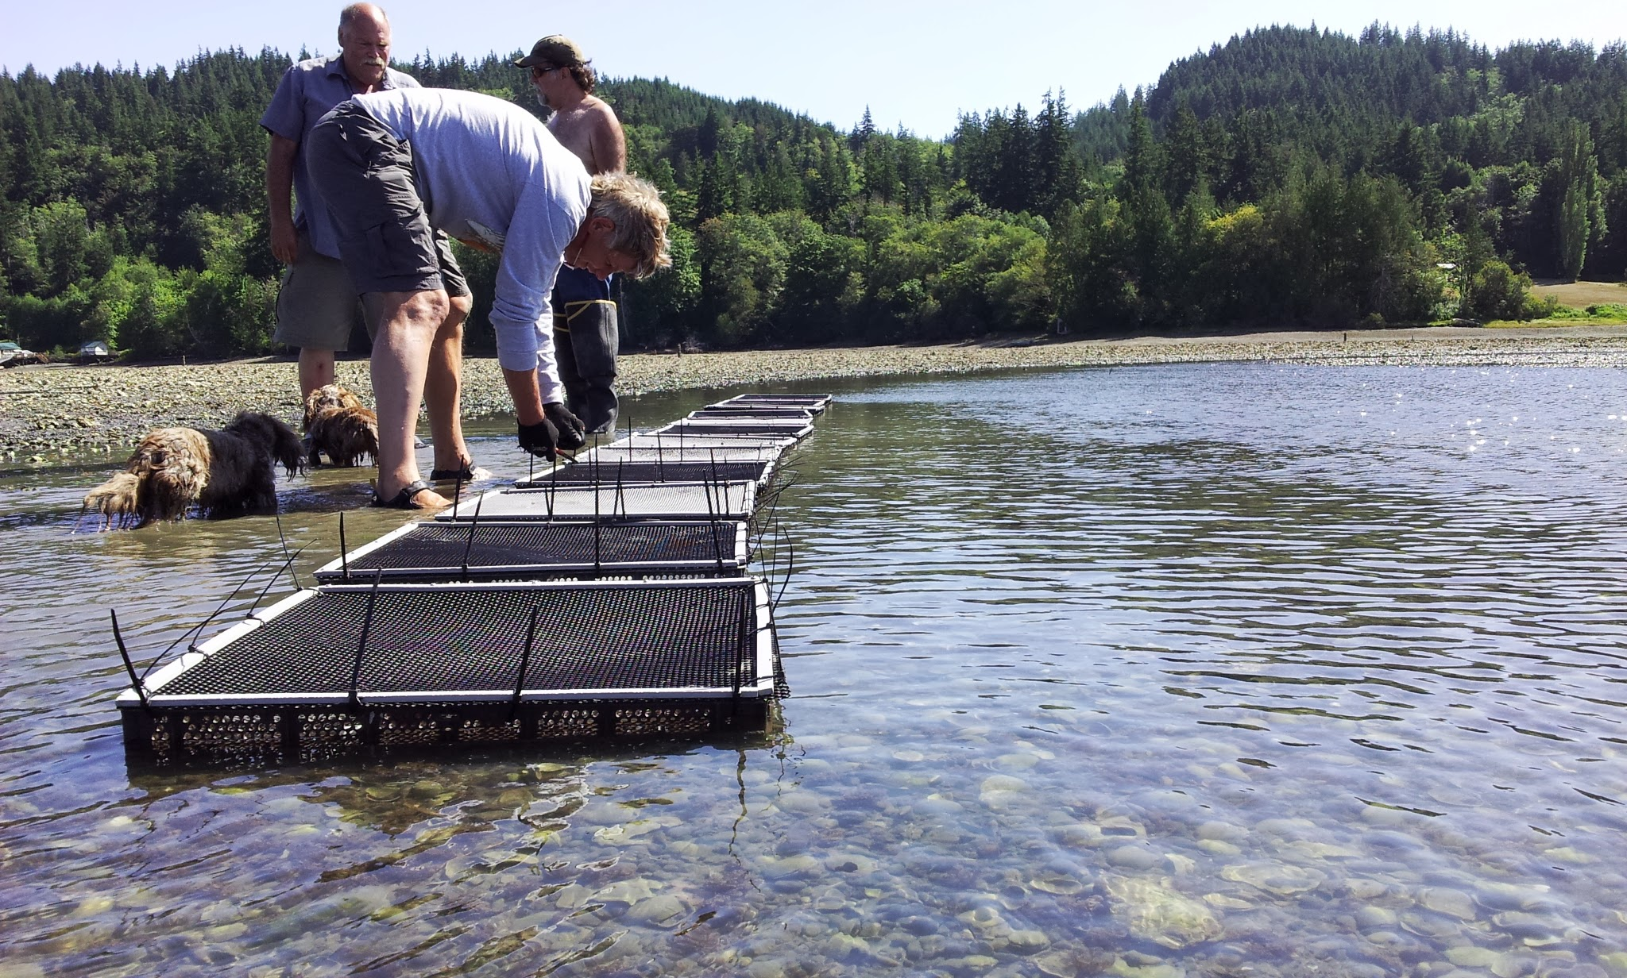
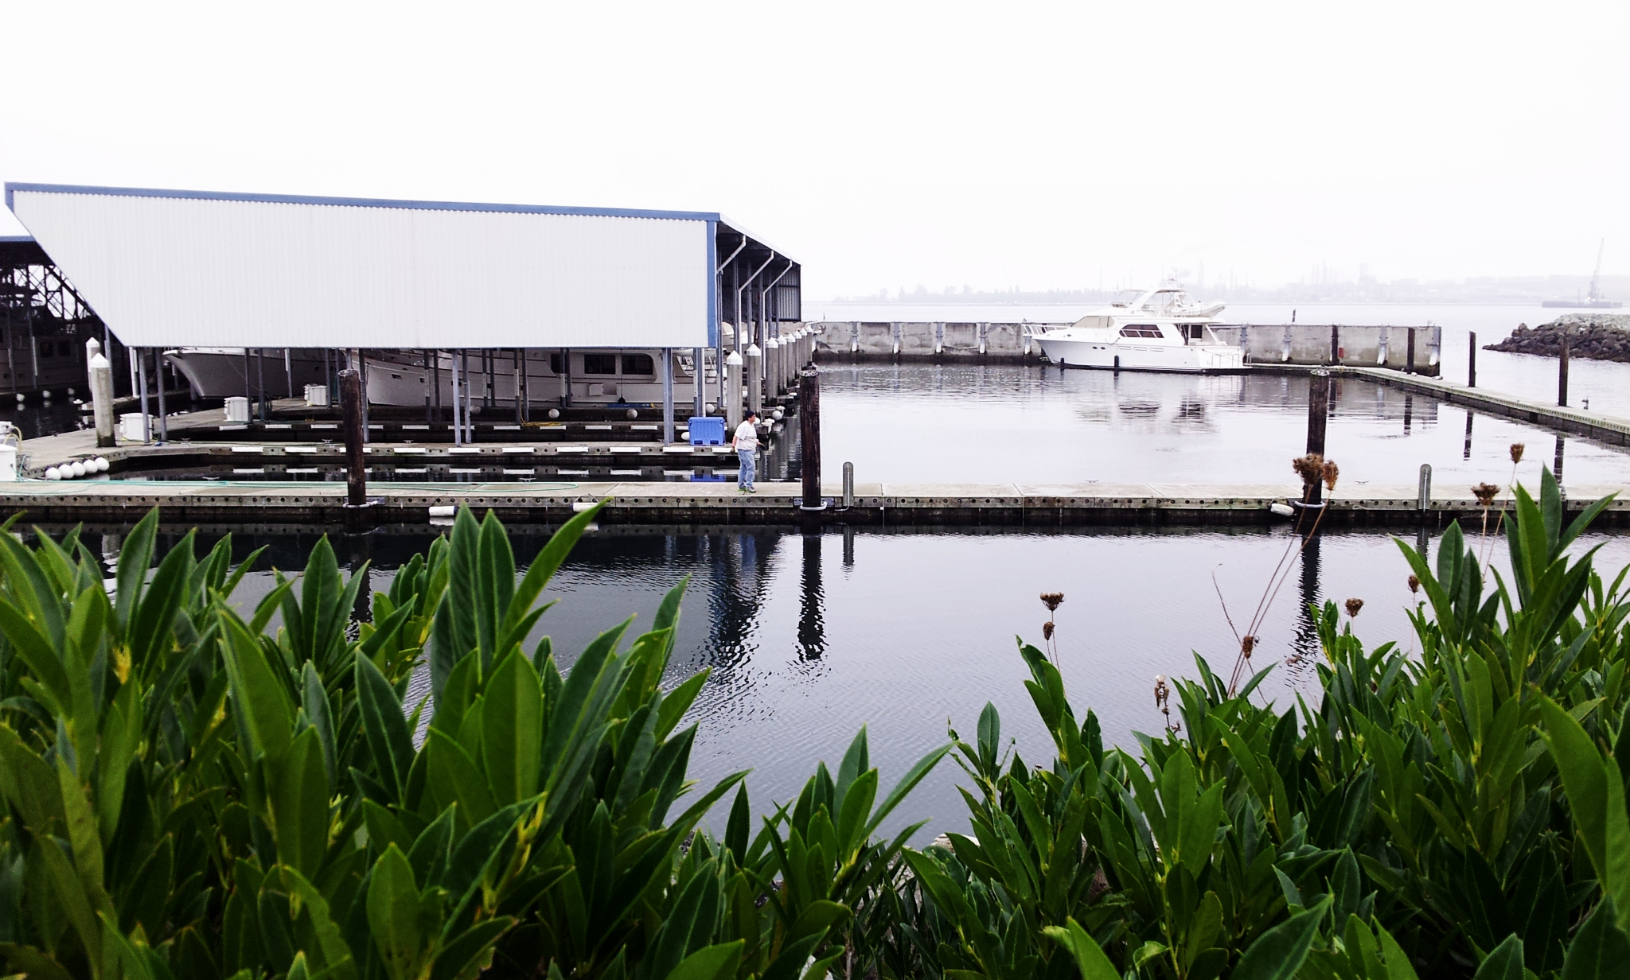
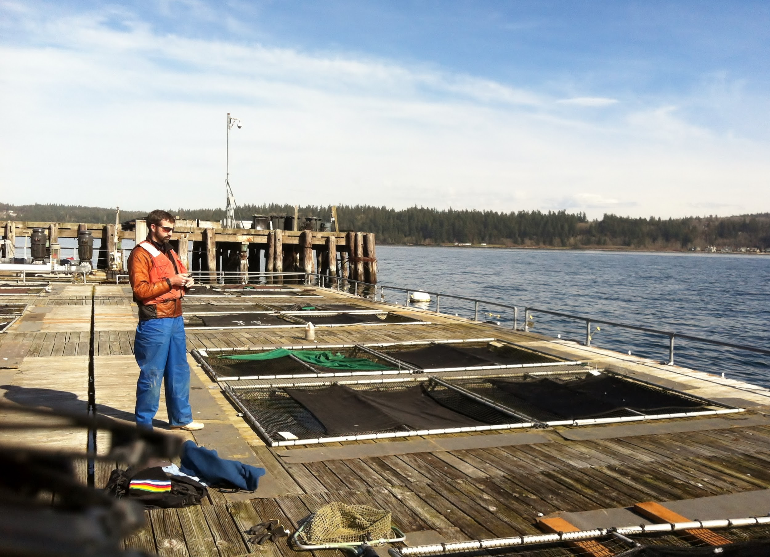
Sites
Dabob Bay
Fidalgo Bay
Oyster Bay
Manchester

Slide 11
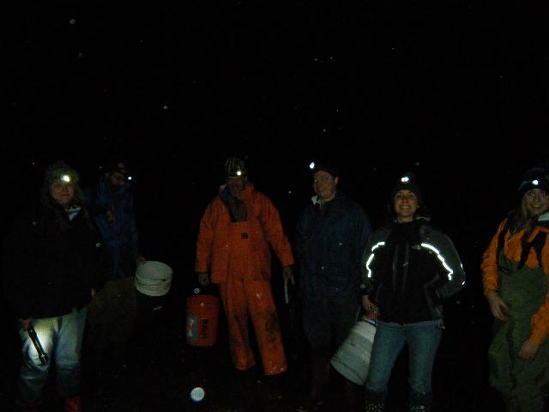
Winter Field Work
Visited 2-4 Months
Collected Dead
Counted Live
Imaged for Size
Maintained Trays

Slide 12
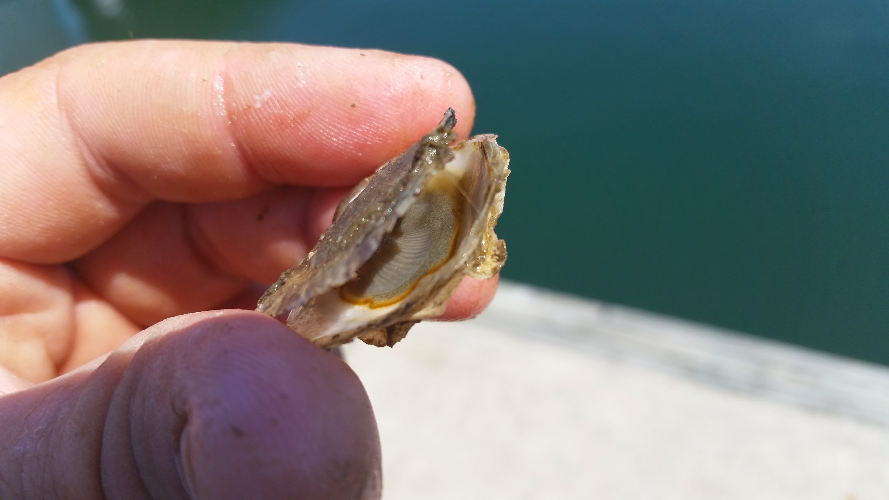
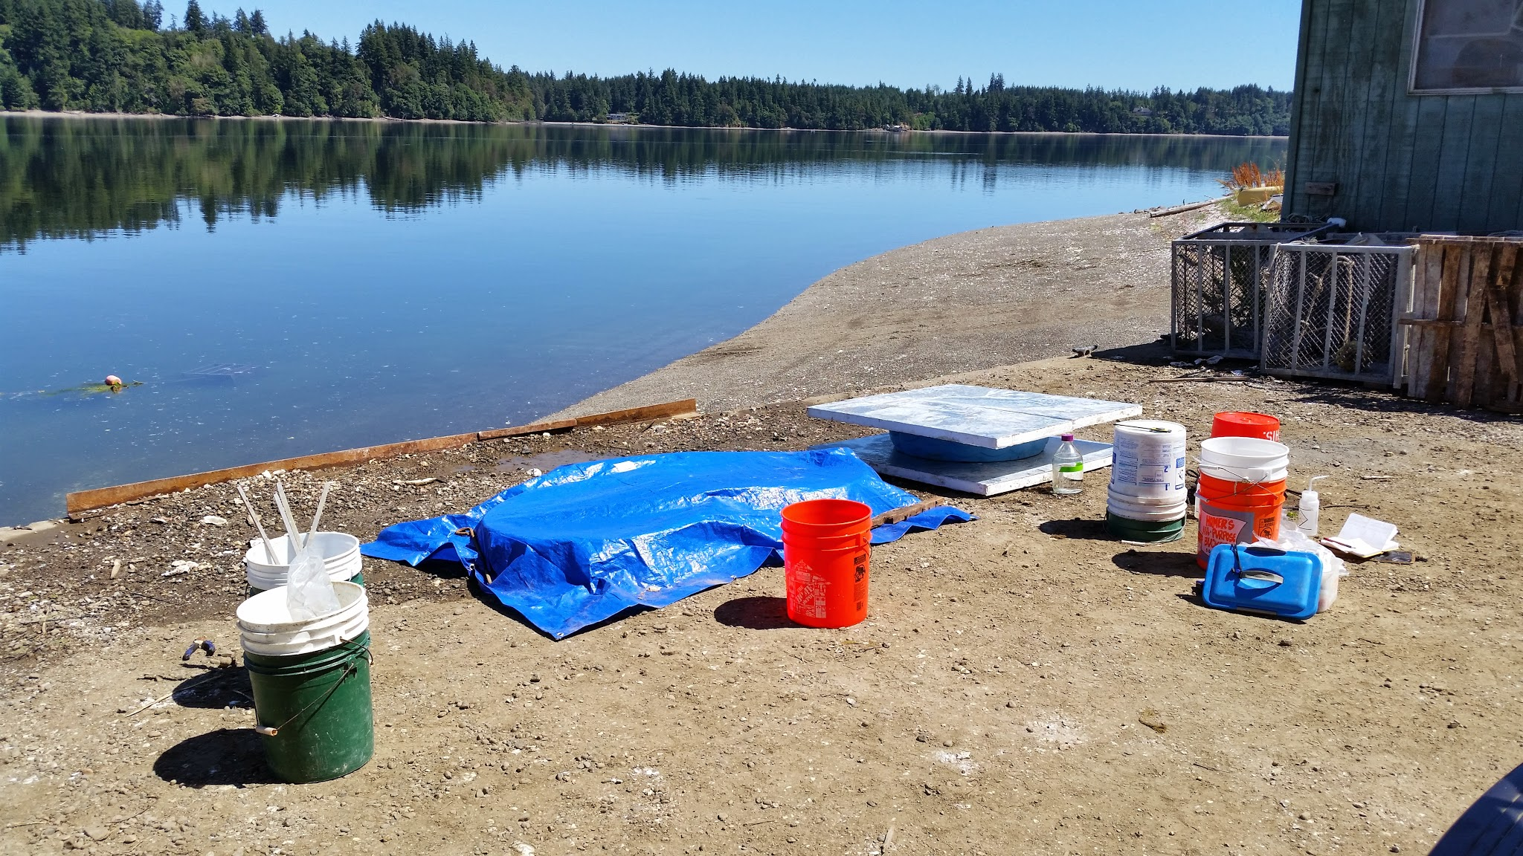
Summer Field Work
15 Weeks
Sampled Brooders
Collected Broods
Hopkins et al. 1936

Slide 13
Key Metrics
What We Want:
Fitness Correlates
Easily Identified
Monitorable
Possible Adaptive Advantage
What We Chose:
Mortality
Growth
Reproduction

Slide 14
Expectations
No difference
Home Field Advantage
Uber-Oyster
???
All Groups Equally Successful
Groups Only Successful at Home
One Group Outperforms
Mixed Results

Slide 15
Outline
Why Local Stocks?
Experiment
Results
Conclusion

Slide 16
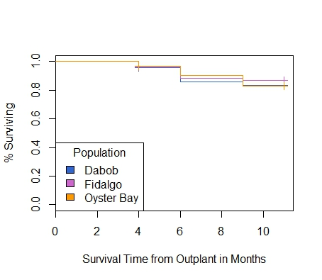
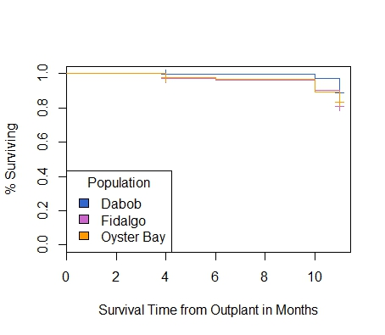
1.0
0.5
0
Aug Oct Dec Feb Apr June
1.0
0.5
0
Mortality
Aug Oct Dec Feb Apr June
Notes:
Make into two slides

Slide 17
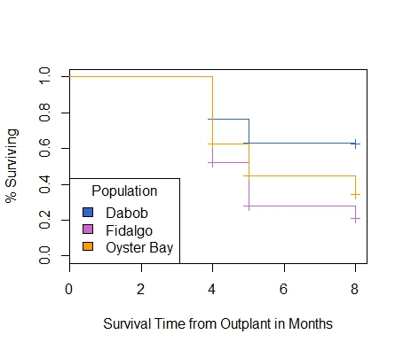
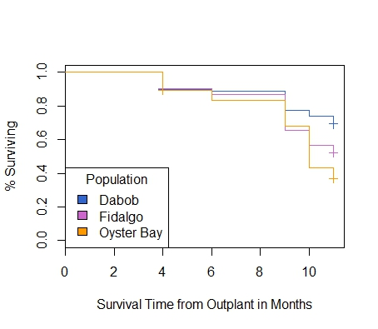
1.0
0.5
0
Aug Oct Dec Feb Apr
1.0
0.5
0
Mortality
Aug Oct Dec Feb Apr June
Notes:
Make into two slides

Slide 18

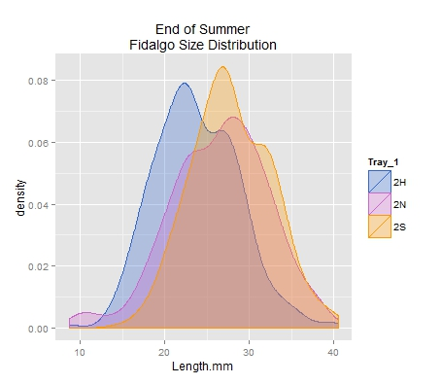
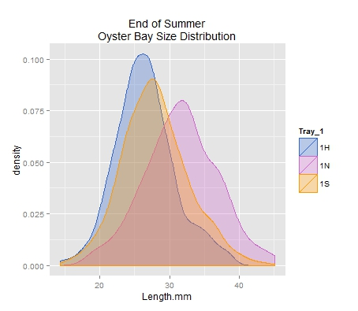
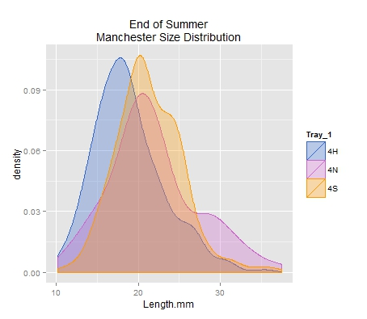
10 20 30 40
Growth
20 30 40
10 20 30

Slide 19
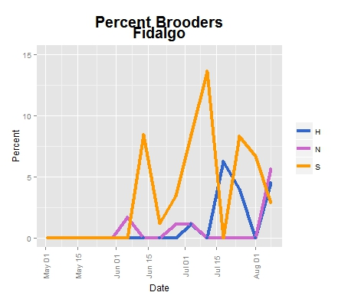
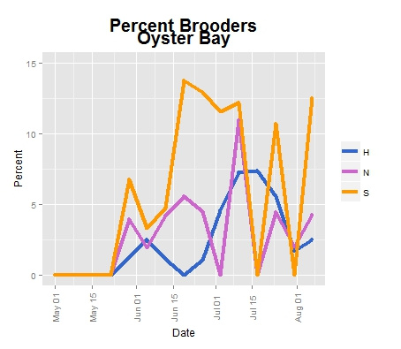
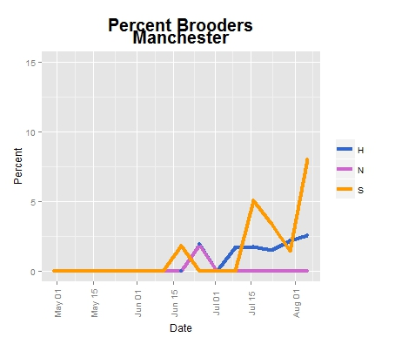
15
10
5
0
May June July Aug
15
10
5
0
15
10
5
0
Reproduction
May June July Aug
May June July Aug

Slide 20
Outline
Why Local Stocks?
Experiment
Results
Conclusion

Slide 21
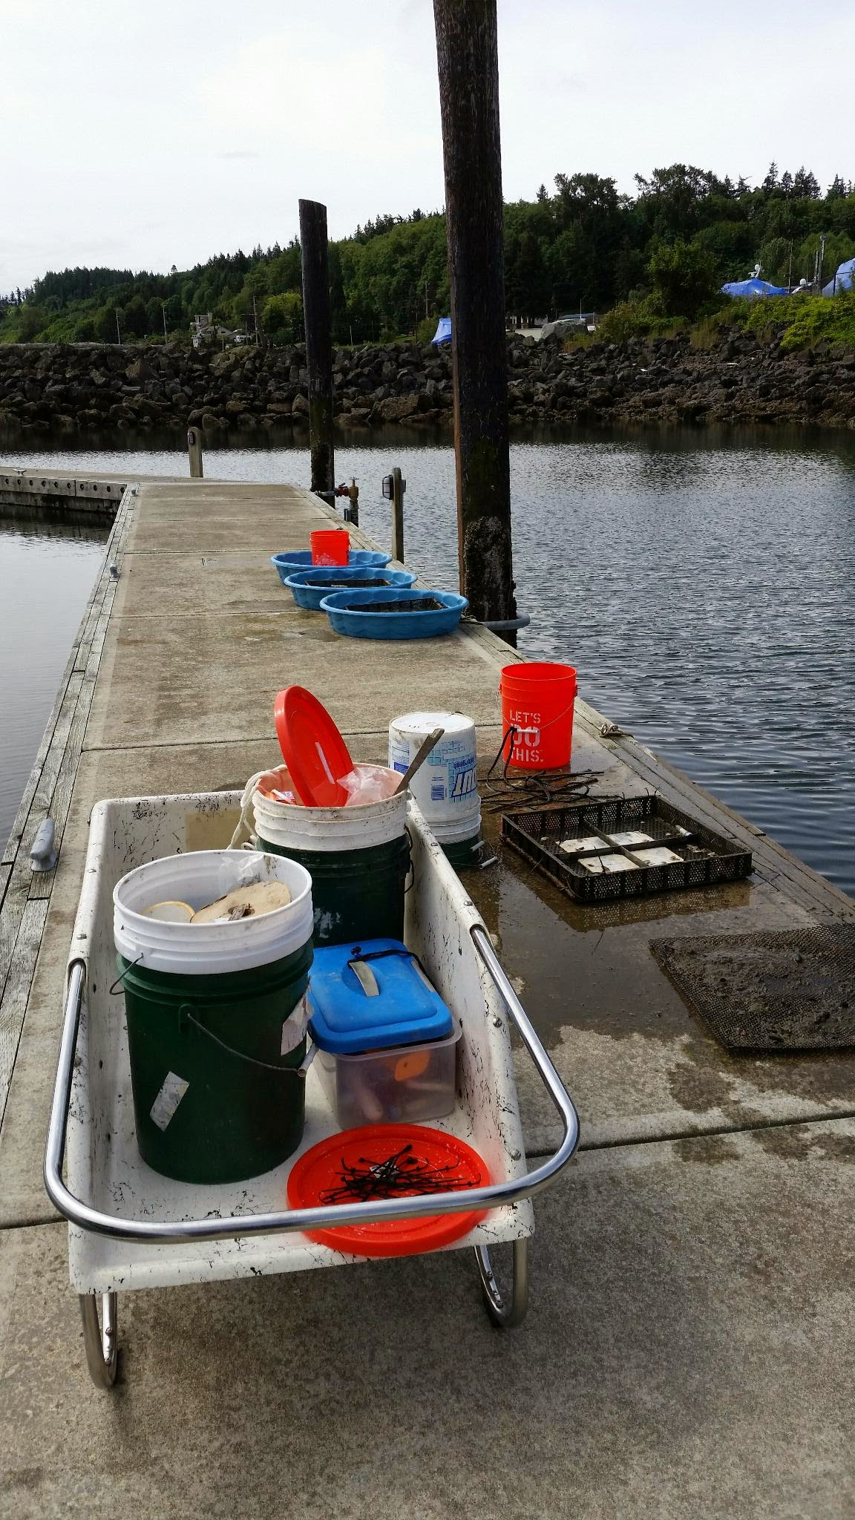
Summary
Mortality
  Dabob Survives Extremes
  Fidalgo High Mortality in Extremes
Growth
  Fidalgo Largest
  Dabob Smallest
Reproduction
  Oyster Bay Most Active
  Dabob Least Active

Slide 22
Expectations Vs. Reality
Equality?
Home Field Advantage?
Uber-Oyster?
???
No
No
No
No Clear Winner/Loser?

Slide 23
Implications
If:
Equality
Homefield Advantage
Uber-Oyster
???
Then:
All Work
Select Based on Site
Easy Choice
Best Guess
Notes:
If, Then statements

Slide 24
Future Research
Population Genomics
Fecundity

Slide 25



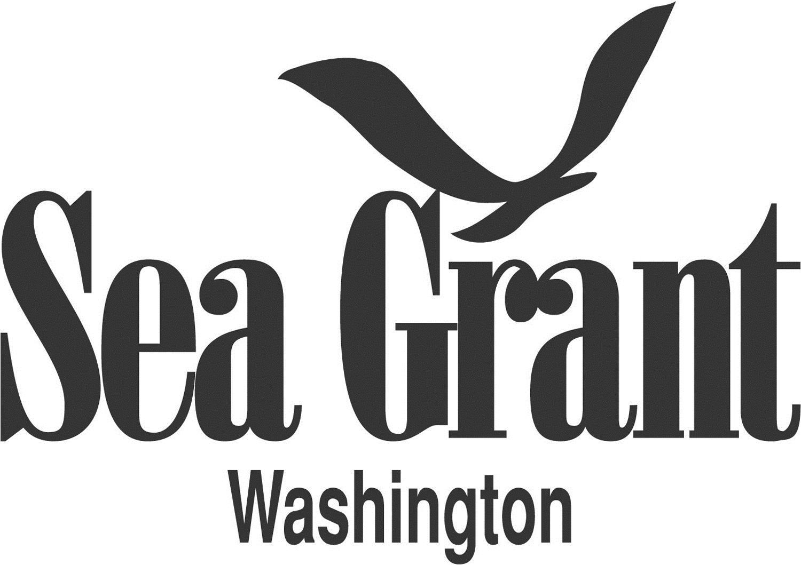

Acknowledgements

Slide 26
Acknowledgements
Roberts Lab:
Sam White
Claire Olson
Mackenzie Gavery
Emma Timmins-Schiffman
Grace Crandall
Jonathon Allen
Etilet Maipi
Samantha Adams
Hannah Wear
Jessica Richards
Katie Jackson
Andy Jasonowicz
Doug Immerman
Giles Goetz
PSRF:
Ryan Crim
Brian Allen
Betsy Peabody
Stuart Ryan
WDFW:
Brady Blake
Crab Fresh:
Brendan Mahaffey
Jeff Koenings
Rick Tweed
Hatchery Crew
Fidalgo Marina:
Einar Sortun
Yacht Owners
Taylor Shellfish:
Molly Jackson
Sara Wykoff
Ed Jones
NOAA:
Rick Goetz
Dive Team
Netpen Crew
Fagergren Family
Rockpoint Oyster Company:
Dick Steele
Crew
Miscellaneous:
L. Christine Savolainen
Sean Bennet
Joelle Blais
Joe Stevick
Bethany Stevick
Lisa Crosson
Alicia Godersky
Lea Savolainen

Slide 27
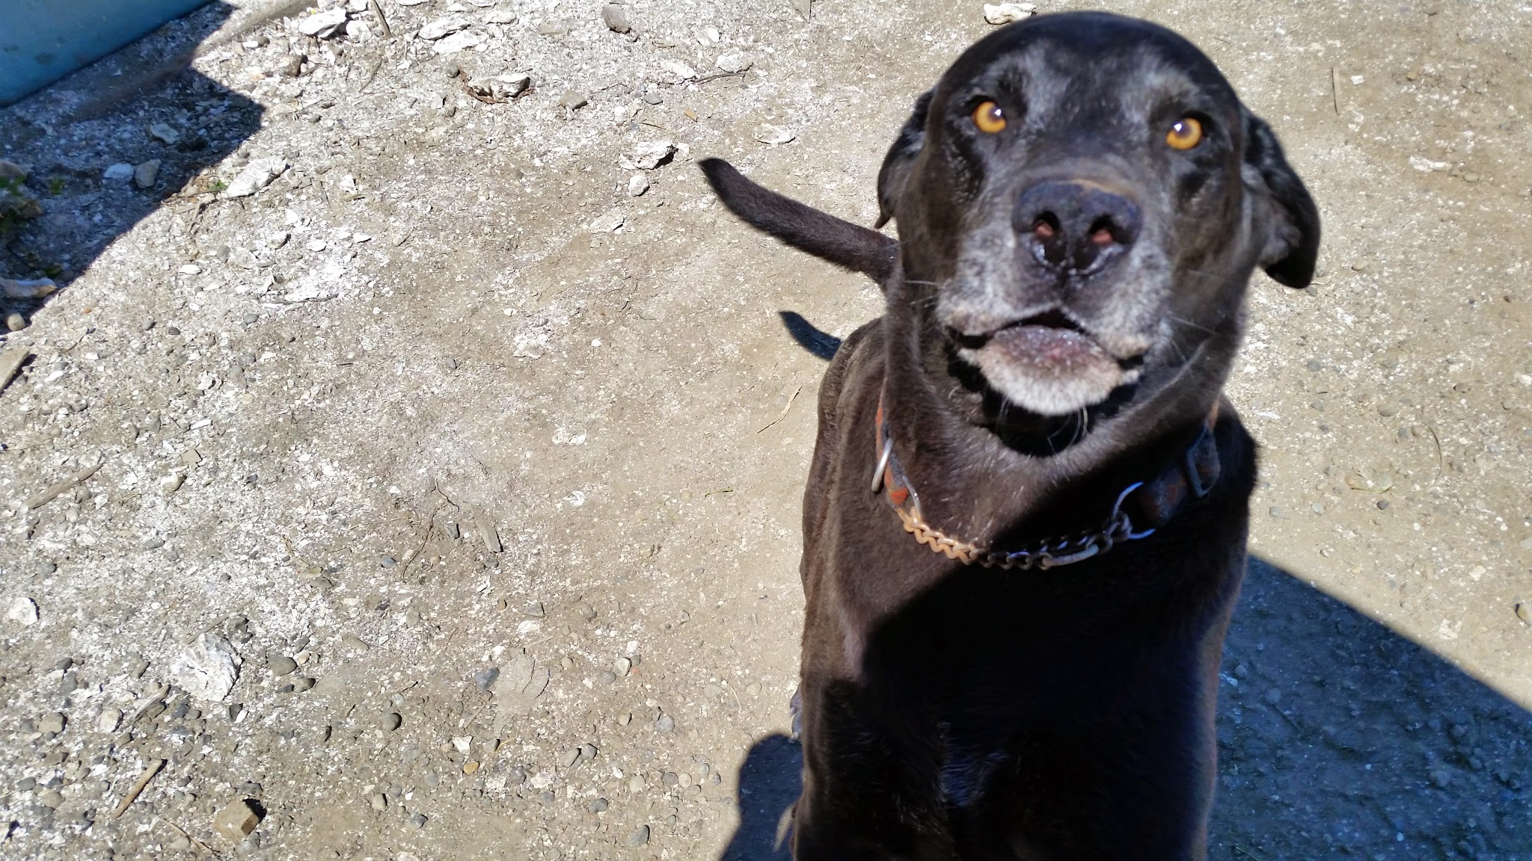
QUESTIONS!
SPECIAL THANKS
TO
JACK
!!!!!!!

Slide 29
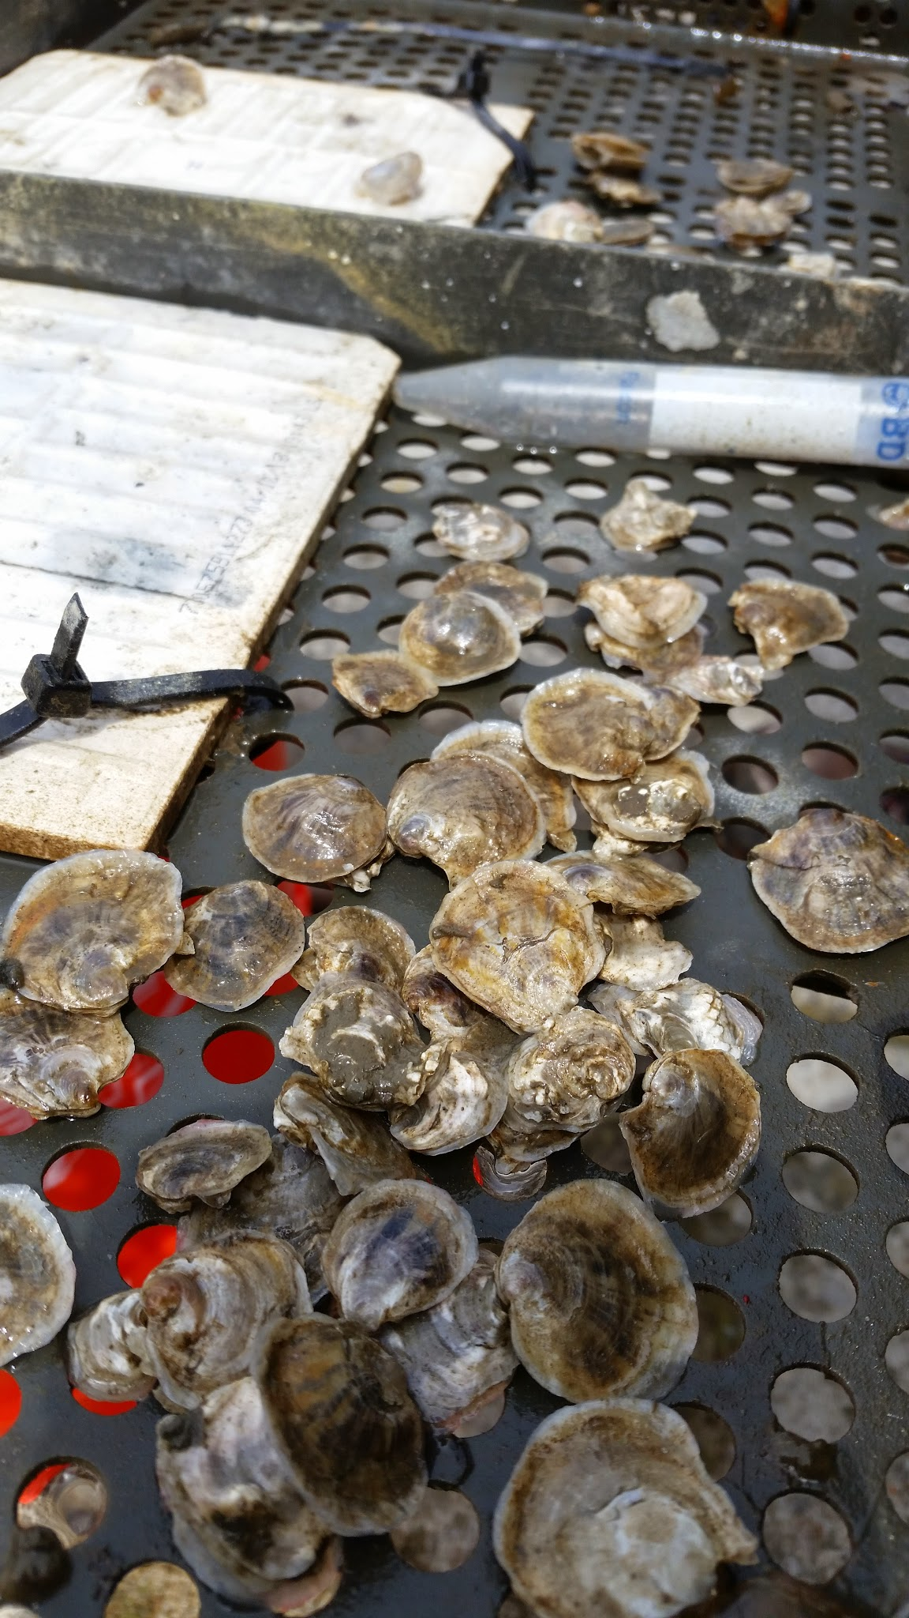
Why Local Stocks?
Dwindling Native Populations
Improve Habitat Viability
Better Adapted?

Slide 30
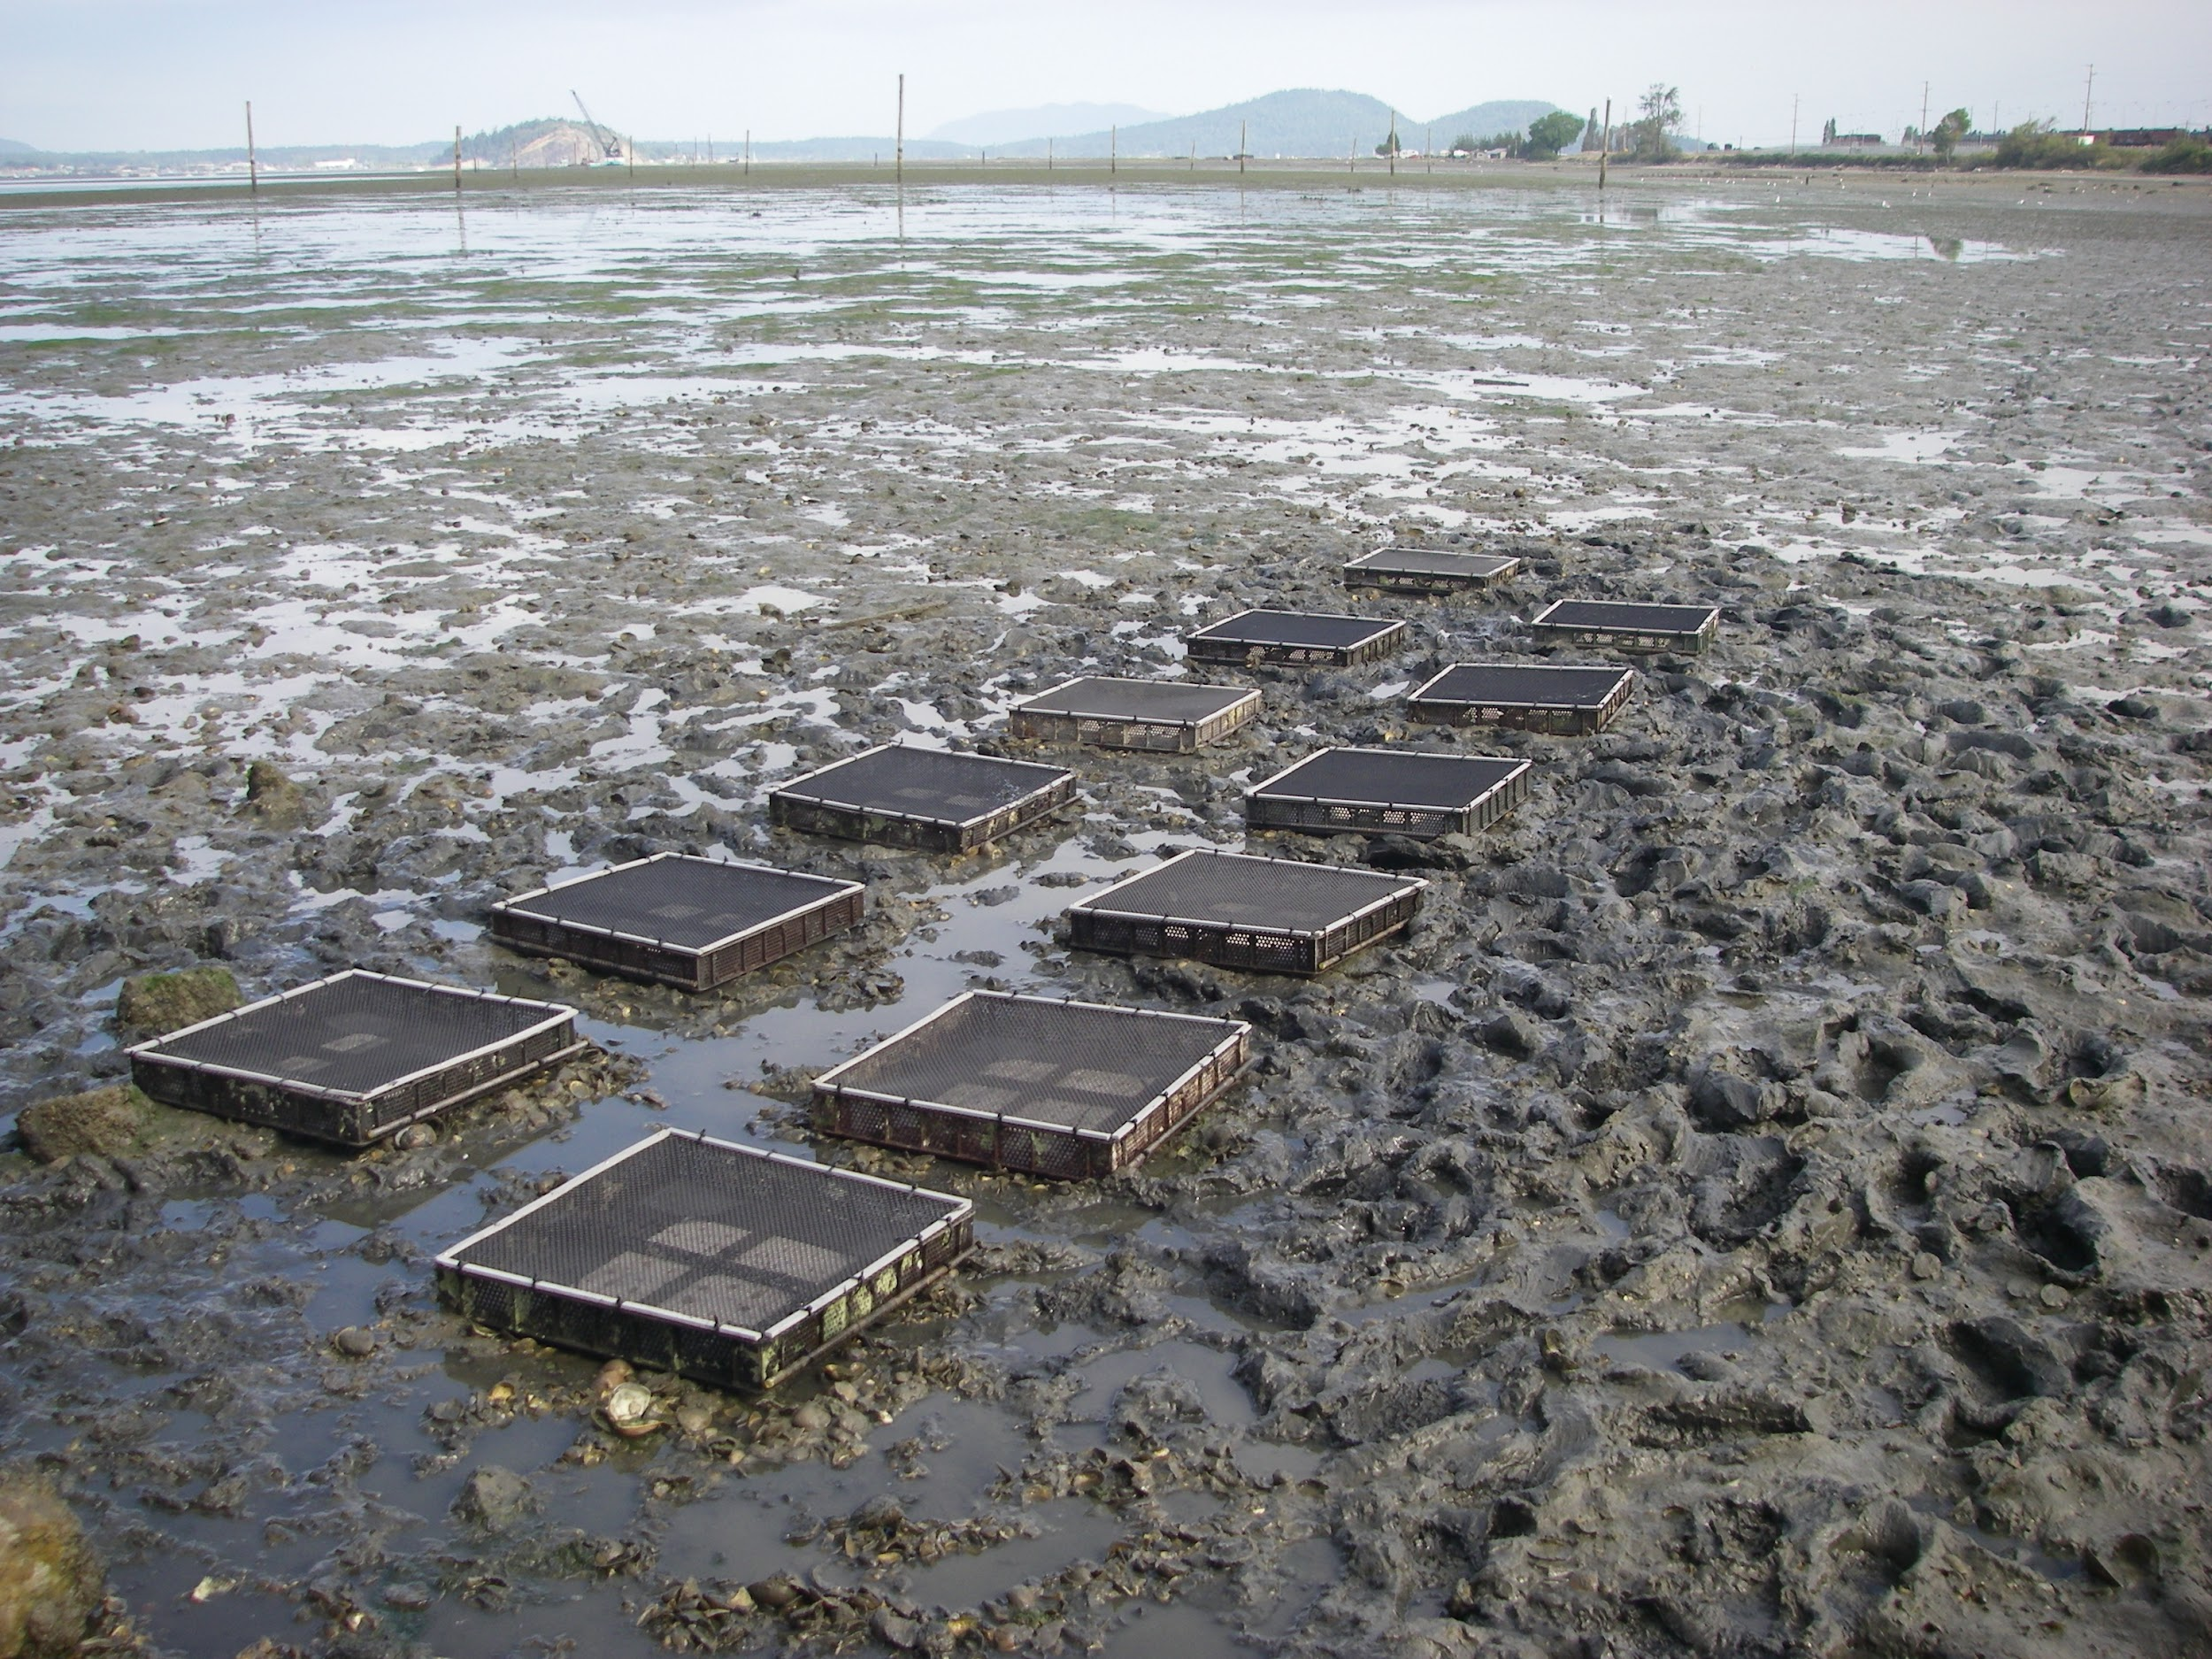
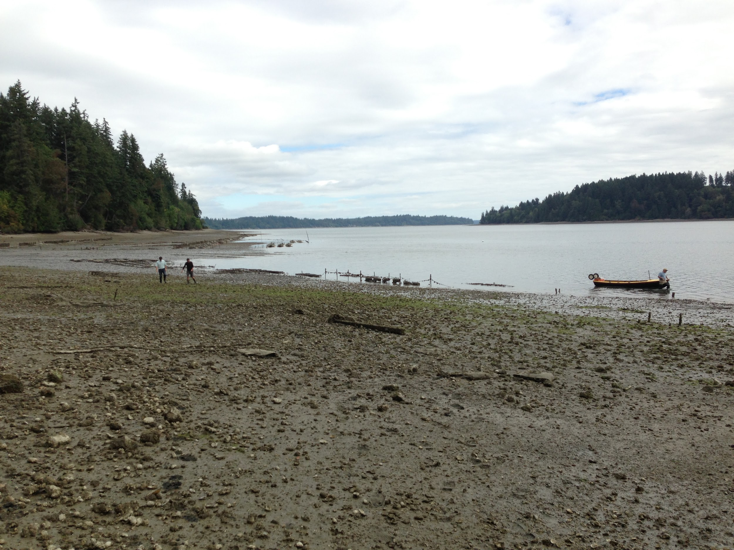
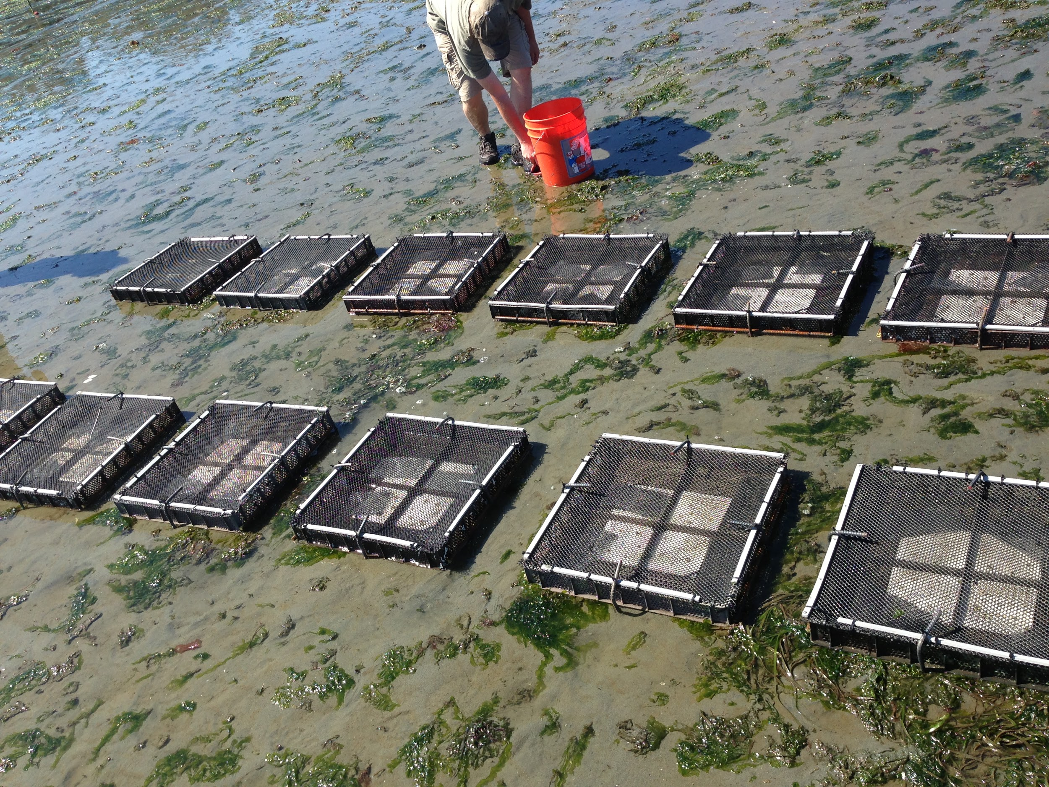
Dabob Bay
Fidalgo Bay
Oyster Bay
Manchester

Slide 31
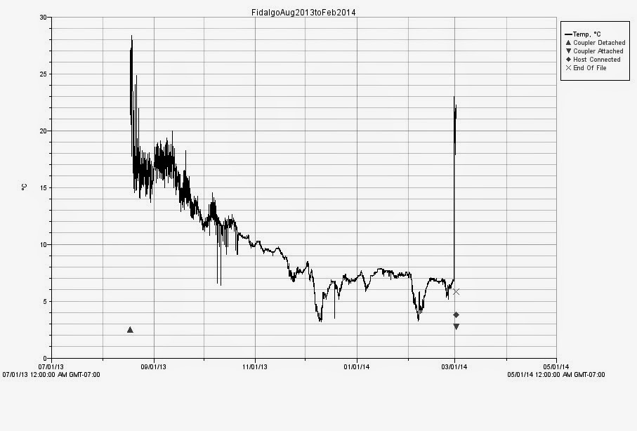
The Big Move
Manchester, Fidalgo, and Oyster Bay
Unforeseen Temperature Extremes
Ensure Survival
Moved from Intertidal to Subtidal

Slide 32
Adaptation to Local Environments
Important to Native Species
Reduces Negative Impacts
  Heat
  Salinity
  DO
Increases Advantages
  Opportunistic
  Energy Allocation
  Spawn Timing
Possible Impact on Outplanting

Slide 33
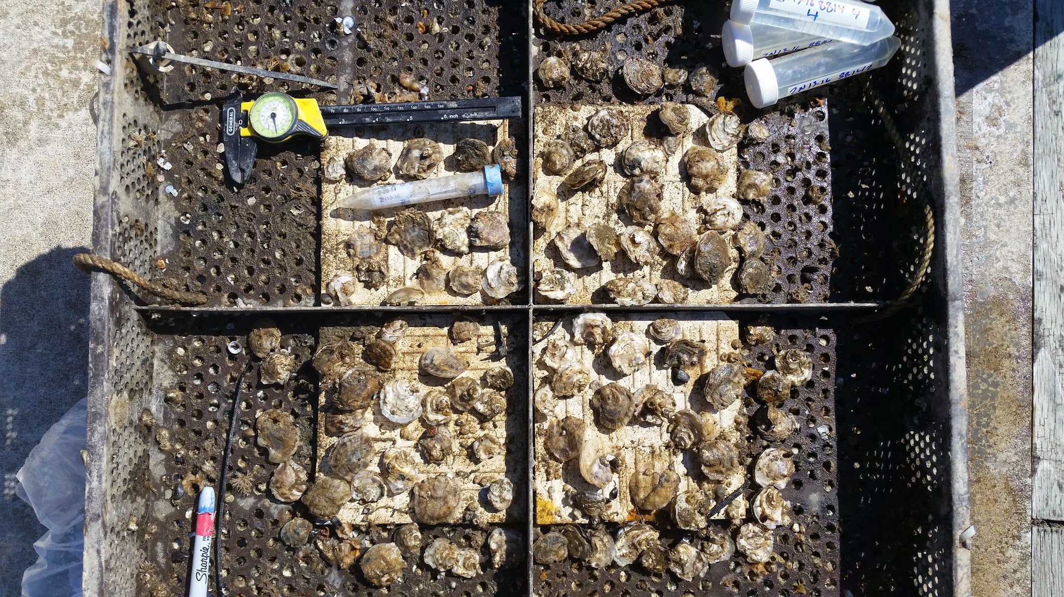
Testing for Adaptation
Reciprocal Transplants
Longitudinal Axis
Origin Bays
  Historic Significance
  Dynamic Environment
  Active Restoration
PSRF Animal Husbandry
F1 generation

Slide 34
Map
Sites located on North-South Axis
Purple = Fidalgo
Blue = Dabob
Orange = Oyster Bay
Red = Manchester*
*Manchester only has transplants.
Interactive map can be accessed here:
http://bit.ly/1l2vNu6
10 miles

Slide 35
What Are We Looking For?
Apparent Differences
Three Key Factors
  Mortality
    Hardiness
  Growth
    Predator Defense
    Reproduction
  Spawning
    Recruitment
    Future

Slide 36
Stages of Outplant Advantage
Broodstock &
Outplantation
Survival & Growth
Advantage
Spawning Advantage
Population Genetic Profile
Stability
Important Year 0
Important Years 1-2
Important Years 1-5
Determines Future Success
Determines
Outplant Survival Success
Determines
Recruitment
Success
Determines
Long term Population
Stability

Slide 37
Differences in Mortality
Oyster Bay
Dabob*
Fidalgo
Manchester

Slide 38
Map
Sites located on North-South Axis
Purple = Fidalgo
Blue = Dabob
Orange = Oyster Bay
Red = Manchester*
*Manchester only has transplants.
Interactive map can be accessed here:
http://bit.ly/1l2vNu6
10 miles

Slide 39
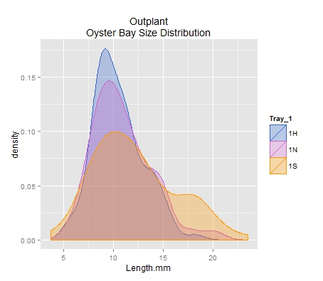
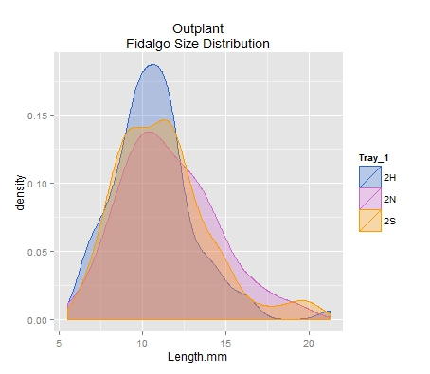
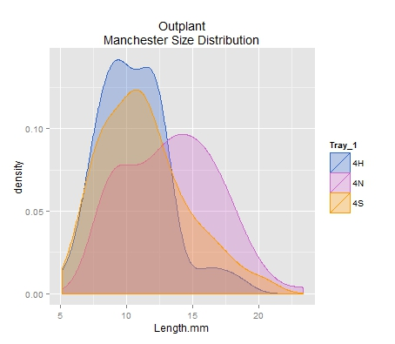
Differences in Growth: Outplant
Based on image analysis of images taken of oysters at outplant at each site. N=96 for each group at each site.

Slide 40
Differences in Growth: Summer
Size Distribution based on image analysis from images taken during July and August 2014.

Slide 41
Map
Sites located on North-South Axis
Purple = Fidalgo
Blue = Dabob
Orange = Oyster Bay
Red = Manchester*
*Manchester only has transplants.
Interactive map can be accessed here:
http://bit.ly/1l2vNu6
10 miles

Slide 42
Differences in Spawning

Slide 43
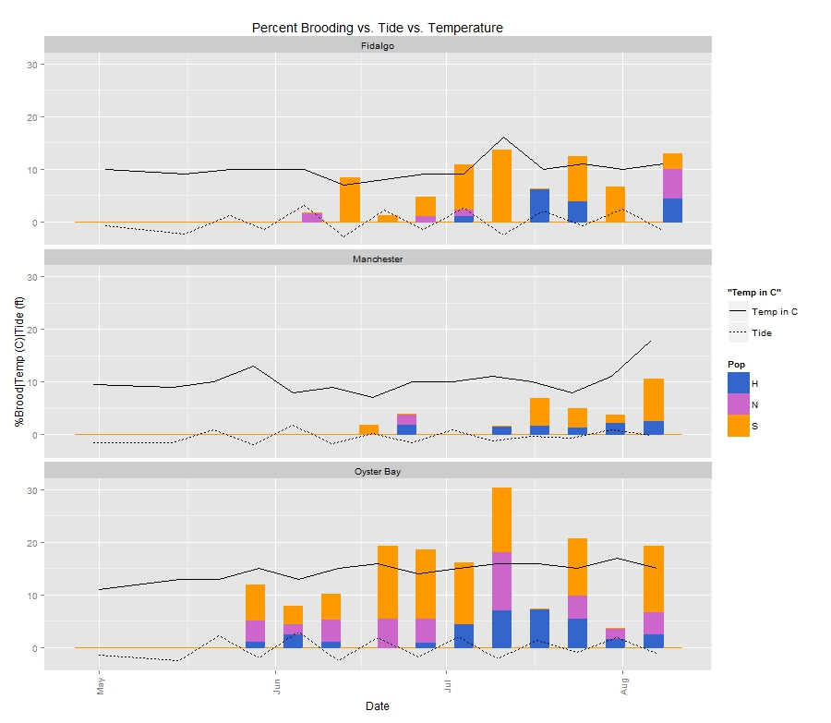
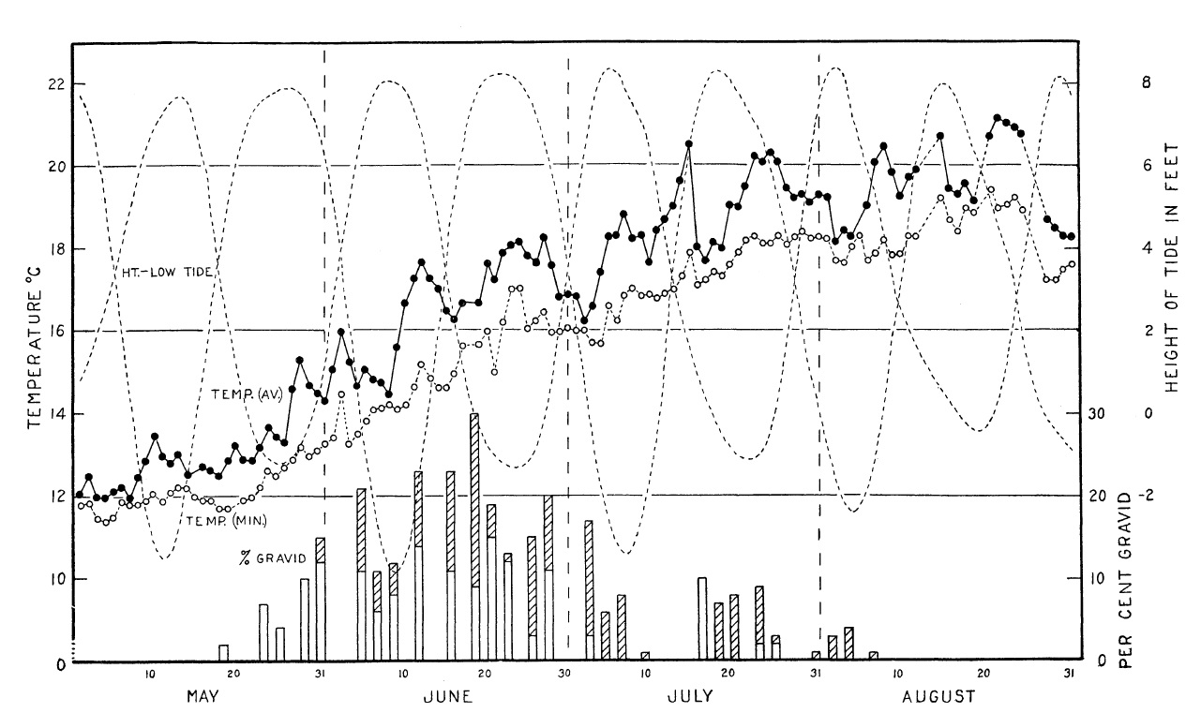
Tide and Temperature

Slide 44
Map
Sites located on North-South Axis
Purple = Fidalgo
Blue = Dabob
Orange = Oyster Bay
Red = Manchester*
*Manchester only has transplants.
Interactive map can be accessed here:
http://bit.ly/1l2vNu6
10 miles

Slide 45
Time, Temp, Site, Size

Slide 46
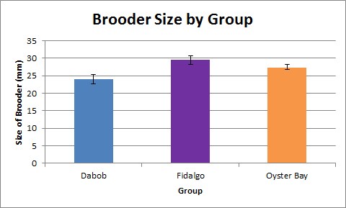
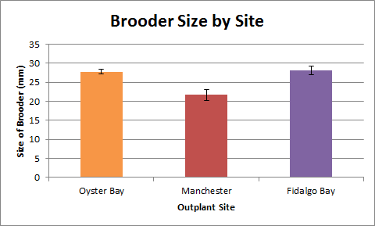
Spawning Size

Slide 47
Differences Summary
Mortality
  Driven by Site
  Tuned by Group
  Dabob Survives Extremes
  Fidalgo High Mortality in Extremes
Growth
  Driven By Site
  Tuned by Group
  Fidalgo Largest
  Dabob Smallest
Spawning
  Volume Driven by Site
  Tuned by Group
  Oyster Bay Most Active
  Dabob Least Active
Spawn Timing
  Driven By Site
  Delayed
Size at Spawn
  Driven by Site and Group
  Affects Spawner Volume

Slide 48
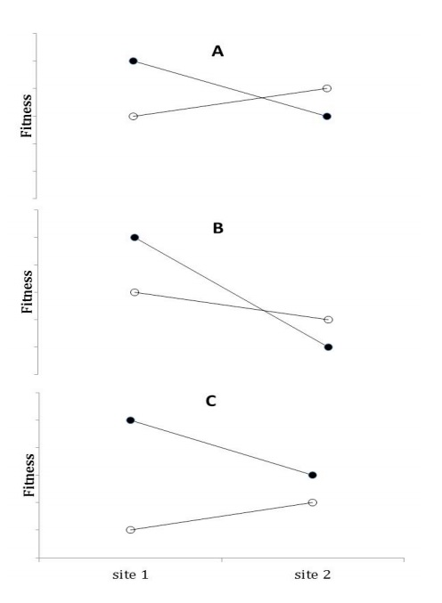
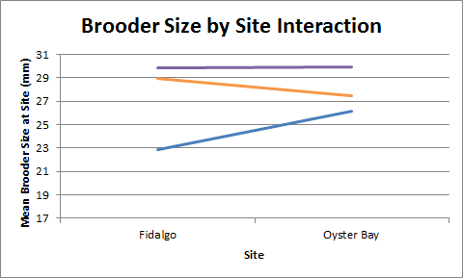
Possible Effects of Local Adaptation

Slide 49
Stages of Outplant Advantage
Broodstock &
Outplantation
Survival & Growth
Advantage
Spawning Advantage
Population Genomics
Important Year 0
Important Years 1-2
Important Years 1-5
Determines Future Success
Determines
Outplant Survival Success
Determines
Recruitment
Success
Determines
Long term Population
Stability

Slide 50
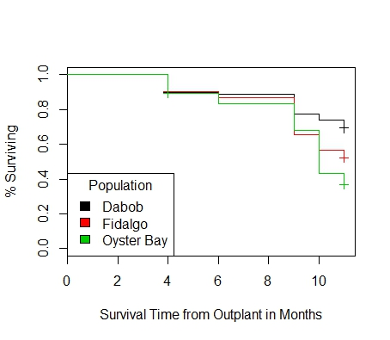
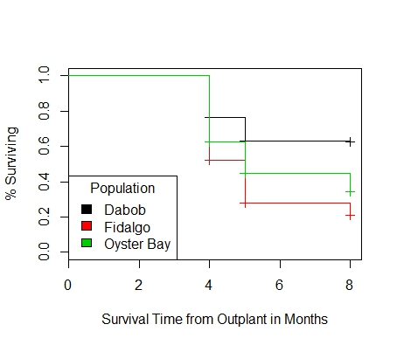
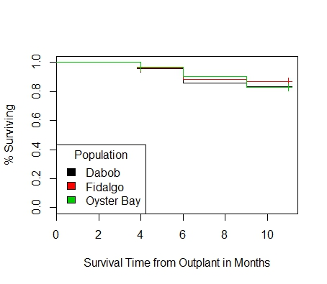
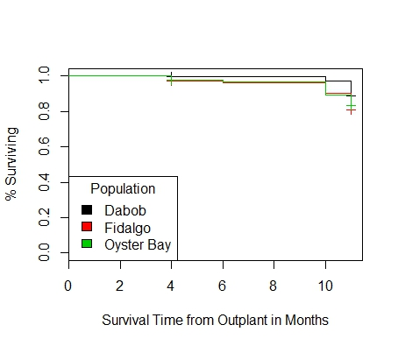
Oyster Bay
Dabob*
Fidalgo
Manchester
Mortality

Slide 51
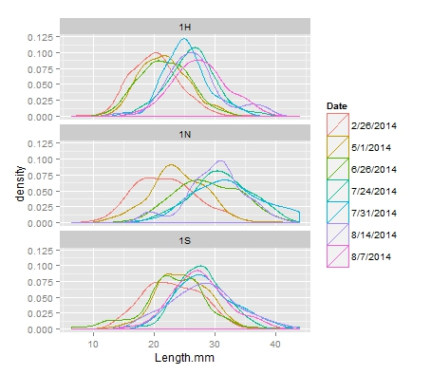
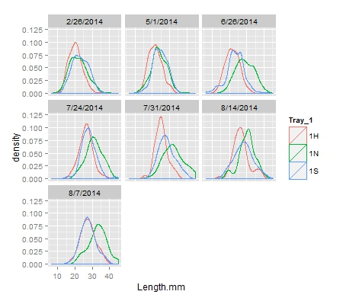
Oyster Bay Size Distribution

Slide 52
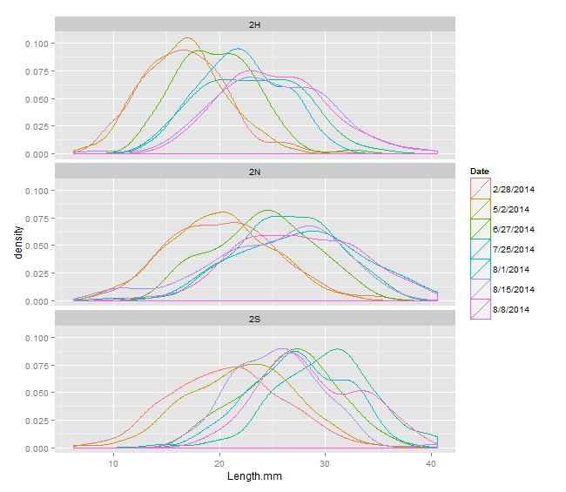
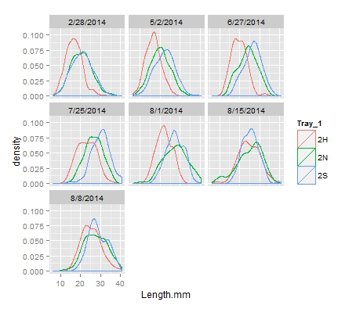
Fidalgo Size Distribution

Slide 53
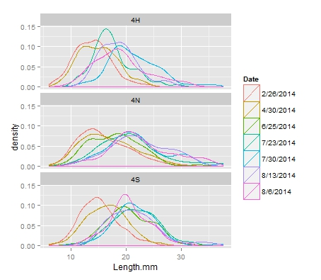
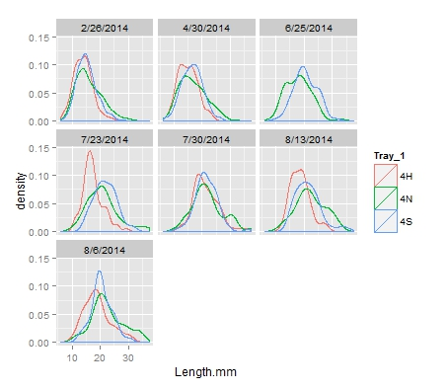
Manchester Size Distribution

Slide 54
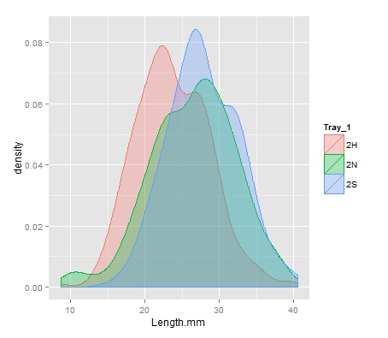


Oyster Bay
Manchester
Fidalgo
Size Distribution

Slide 55


Number of Broods Produced

Slide 56


Percent of Sample Brooding

Slide 57
Percent Brood vs Size

